Slide 1
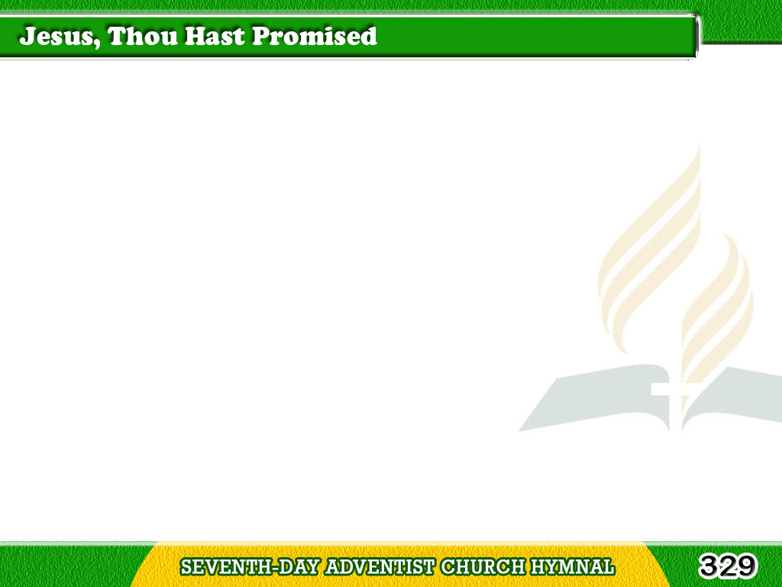
1/3
Jesus, thou hast promised
That where two or three
In Thy name have gathered,
Thou wilt present be;
Tagalog
Version

Slide 2
1/3
And Thy word believing,
Now in prayer we kneel;
Jesus come and bless us;
Lord Thyself reveal.
Tagalog
Version

Slide 3
1/3
Chorus
Jesus, come and bless us
While we linger here;
Jesus, come and bless us,
Be Thou ever near.
Tagalog
Version

Slide 4
2/3
Jesus, Thou hast met us
Oft in seasons past,
But we need Thy presence
With us till the last;
Tagalog
Version

Slide 5
2/3
Come, O blessed Saviour,
And Thy grace display;
Hear us and accept us;
Bless us while we pray.
Tagalog
Version

Slide 6
2/3
Chorus
Jesus, come and bless us
While we linger here;
Jesus, come and bless us,
Be Thou ever near.
Tagalog
Version

Slide 7
3/3
Jesus, tune our voices
To Thy songs of praise,
Be in each petition
That to Thee we raise;
Tagalog
Version

Slide 8
3/3
May our faith grow stronger;
And our hope more bright;
May our love be purer,
And our path more light.
Tagalog
Version

Slide 9
3/3
Chorus
Jesus, come and bless us
While we linger here;
Jesus, come and bless us,
Be Thou ever near.
Tagalog
Version

